Slide 1

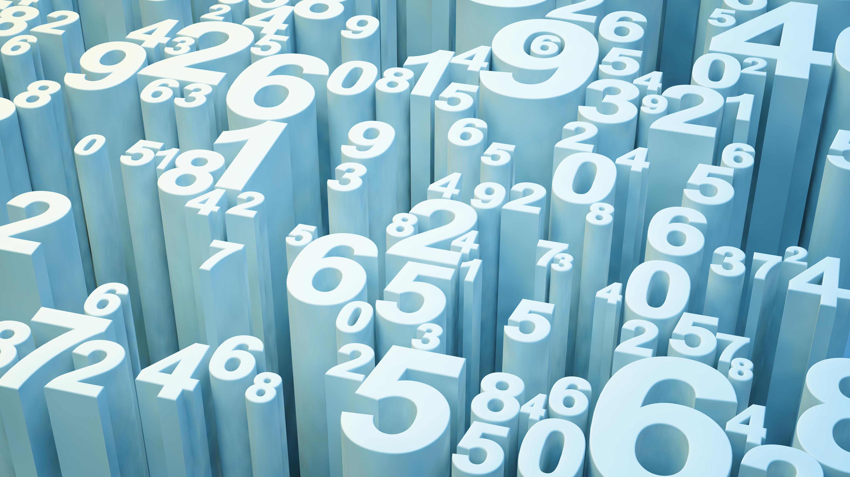
Python and Matplotlib

Slide 2
Example One your first graph
import matplotlib.pyplot as plt
x = [1,2,3] # x axis values
y = [2,4,1] # corresponding y axis values
plt.plot(x, y) # plotting the points
plt.xlabel('x - axis’) # naming the x axis
plt.ylabel('y - axis’) # naming the y axis
plt.title('My first graph!’) # giving a title to my graph
plt.show() # function to show the plot

Slide 3
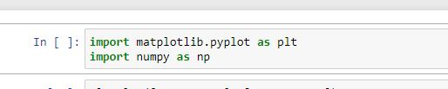
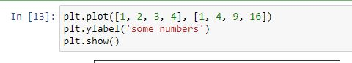
Example Two

Slide 4
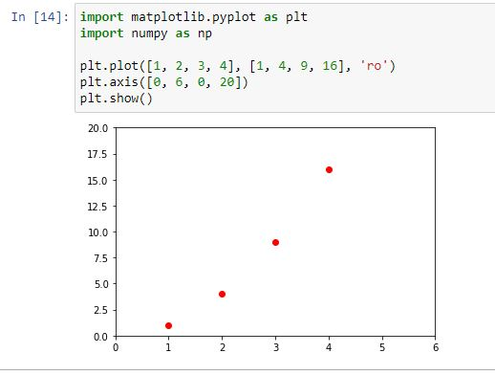
Example Three

Slide 5
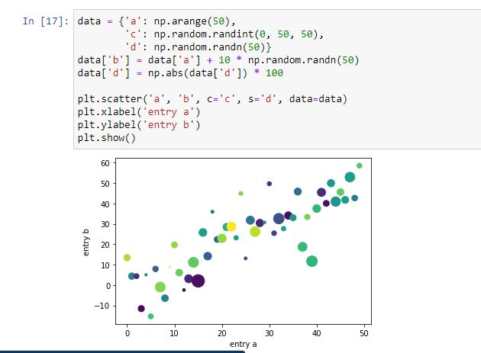
Example Four

Slide 6
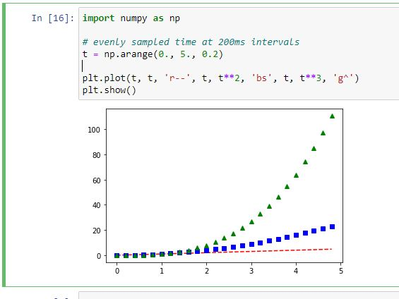
Example Five

Slide 7
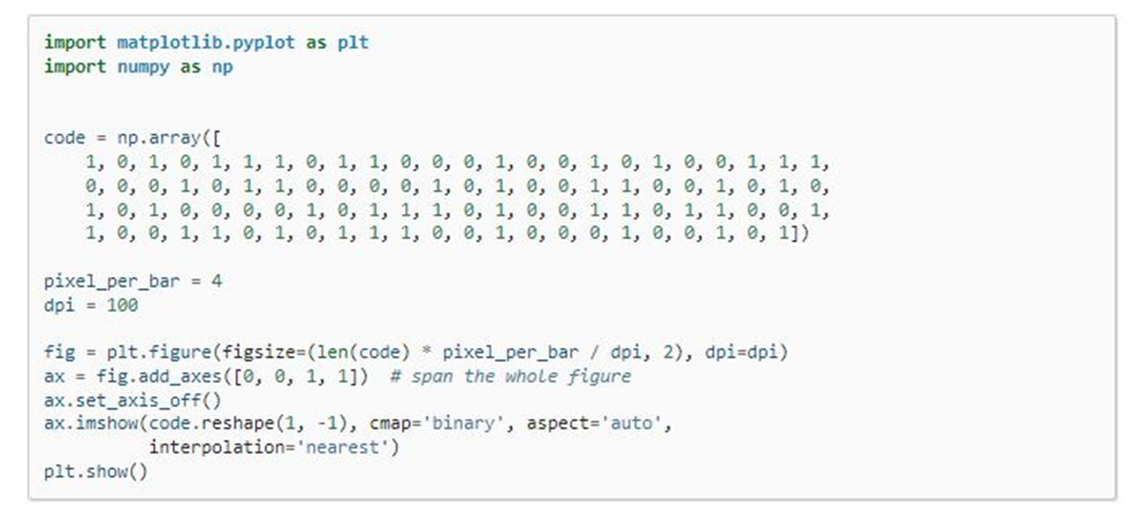
Example Six

Slide 8
Example Seven
import matplotlib.pyplot as plt
a = [1, 2, 3, 4, 5]
b = [0, 0.6, 0.2, 15, 10, 8, 16, 21]
plt.plot(a)
plt.plot(b, "or") # o is for circles and r is for red
plt.plot(list(range(0, 22, 3)))
plt.xlabel('Day ->’) # naming the x-axis
plt.ylabel('Temp ->’) # naming the y-axis

Slide 9
c = [4, 2, 6, 8, 3, 20, 13, 15]
plt.plot(c, label = '4th Rep')
ax = plt.gca() # get current axes command
# set command over the individual boundary line of the graph body
ax.spines['right'].set_visible(False)
ax.spines['top'].set_visible(False)
# set the range or the bounds of the left boundary line to fixed range
ax.spines['left'].set_bounds(-3, 40)
# set the interval by which the x-axis set the marks
plt.xticks(list(range(-3, 10)))
Example Seven
continued

Slide 10
# set the intervals by which y-axis set the marks
plt.yticks(list(range(-3, 20, 3)))
# legend denotes what color signifies what
ax.legend(['1st Rep', '2nd Rep', '3rd Rep', '4th Rep'])
# annotate command helps to write ON THE GRAPH any text
# xy denotes the position on the graph
plt.annotate('Temperature V / s Days', xy = (1.01, -2.15))
# gives a title to the Graph
plt.title('All Features Discussed')
plt.show()
Example Seven
continued

Slide 11
import matplotlib.pyplot as plt
a = [1, 2, 3, 4, 5]
b = [0, 0.6, 0.2, 15, 10, 8, 16, 21]
c = [4, 2, 6, 8, 3, 20, 13, 15]
# use fig whenever u want the
# output in a new window also
# specify the window size you
# want answer to be displayed
fig = plt.figure(figsize =(10, 10))
Example
Eight

Slide 12
# creating multiple plots in a single plot
sub1 = plt.subplot(2, 2, 1)
sub2 = plt.subplot(2, 2, 2)
sub3 = plt.subplot(2, 2, 3)
sub4 = plt.subplot(2, 2, 4)
sub1.plot(a, 'sb')
# sets how the display subplot
# x axis values advances by 1
# within the specified range
sub1.set_xticks(list(range(0, 10, 1)))
sub1.set_title('1st Rep')
sub2.plot(b, 'or')
Example
Eight continued

Slide 13
# sets how the display subplot x axis
# values advances by 2 within the
# specified range
sub2.set_xticks(list(range(0, 10, 2)))
sub2.set_title('2nd Rep')
# can directly pass a list in the plot
# function instead adding the reference
sub3.plot(list(range(0, 22, 3)), 'vg')
sub3.set_xticks(list(range(0, 10, 1)))
sub3.set_title('3rd Rep')
Example
Eight continued

Slide 14
sub4.plot(c, 'Dm')
# similarly we can set the ticks for
# the y-axis range(start(inclusive),
# end(exclusive), step)
sub4.set_yticks(list(range(0, 24, 2)))
sub4.set_title('4th Rep')
# without writing plt.show() no plot will be visible
plt.show()
Example
Eight continued

Slide 15
import matplotlib.pyplot as plt
# line 1 points
x1 = [1,2,3]
y1 = [2,4,1]
# plotting the line 1 points
plt.plot(x1, y1, label = "line 1")
# line 2 points
x2 = [1,2,3]
y2 = [4,1,3]
# plotting the line 2 points
plt.plot(x2, y2, label = "line 2")
Example
Nine

Slide 16
# naming the x axis
plt.xlabel('x - axis’)
# naming the y axis
plt.ylabel('y - axis’)
# giving a title to my graph
plt.title('Two lines on same graph!')
# show a legend on the plot
plt.legend()
# function to show the plot
plt.show()
Example
Nine
Continued

Slide 17
Example
Ten
import matplotlib.pyplot as plt
# x axis values
x = [1,2,3,4,5,6]
# corresponding y axis values
y = [2,4,1,5,2,6]
# plotting the points
plt.plot(x, y, color='green', linestyle='dashed', linewidth = 3,
marker='o', markerfacecolor='blue', markersize=12)

Slide 18
# setting x and y axis range
plt.ylim(1,8)
plt.xlim(1,8)
# naming the x axis
plt.xlabel('x - axis')
# naming the y axis
plt.ylabel('y - axis')
# giving a title to my graph
plt.title('Some cool customizations!')
# function to show the plot
plt.show()

Slide 19
Example
Eleven
import matplotlib.pyplot as plt
# x-coordinates of left sides of bars
left = [1, 2, 3, 4, 5]
# heights of bars
height = [10, 24, 36, 40, 5]
# labels for bars
tick_label = ['one', 'two', 'three', 'four', 'five']

Slide 20
# plotting a bar chart
plt.bar(left, height, tick_label = tick_label,
width = 0.8, color = ['red', 'green'])
# naming the x-axis
plt.xlabel('x - axis')
# naming the y-axis
plt.ylabel('y - axis')
# plot title
plt.title('My bar chart!')
# function to show the plot
plt.show()

Slide 21
Example
Twelve
import matplotlib.pyplot as plt
# frequencies
ages = [2,5,70,40,30,45,50,45,43,40,44,
60,7,13,57,18,90,77,32,21,20,40]
# setting the ranges and no. of intervals
range = (0, 100)
bins = 10
# plotting a histogram
plt.hist(ages, bins, range, color = 'green',
histtype = 'bar', rwidth = 0.8)

Slide 22
# x-axis label
plt.xlabel('age')
# frequency label
plt.ylabel('No. of people')
# plot title
plt.title('My histogram')
# function to show the plot
plt.show()

Slide 23
import matplotlib.pyplot as plt
activities = ['eat', 'sleep', 'work', 'play’] # defining labels
slices = [3, 7, 8, 6] # portion covered by each label
colors = ['r', 'y', 'g', 'b’] # color for each label
# plotting the pie chart
plt.pie(slices, labels = activities, colors=colors,
startangle=90, shadow = True, explode = (0, 0, 0.1, 0),
radius = 1.2, autopct = '%1.1f%%')
plt.legend() # plotting legend
plt.show() # showing the plot
Example
Thirteen

Slide 24
# importing the required modules
import matplotlib.pyplot as plt
import numpy as np
# setting the x - coordinates
x = np.arange(0, 2*(np.pi), 0.1)
# setting the corresponding y - coordinates
y = np.sin(x)
# plotting the points
plt.plot(x, y)
# function to show the plot
plt.show()
Example
Fourteen

Slide 25
import matplotlib.pyplot as plt
import numpy as np
ypoints = np.array([3, 8, 1, 10, 5, 7])
plt.plot(ypoints)
plt.show()
Example
Fifteen

